Slide 1
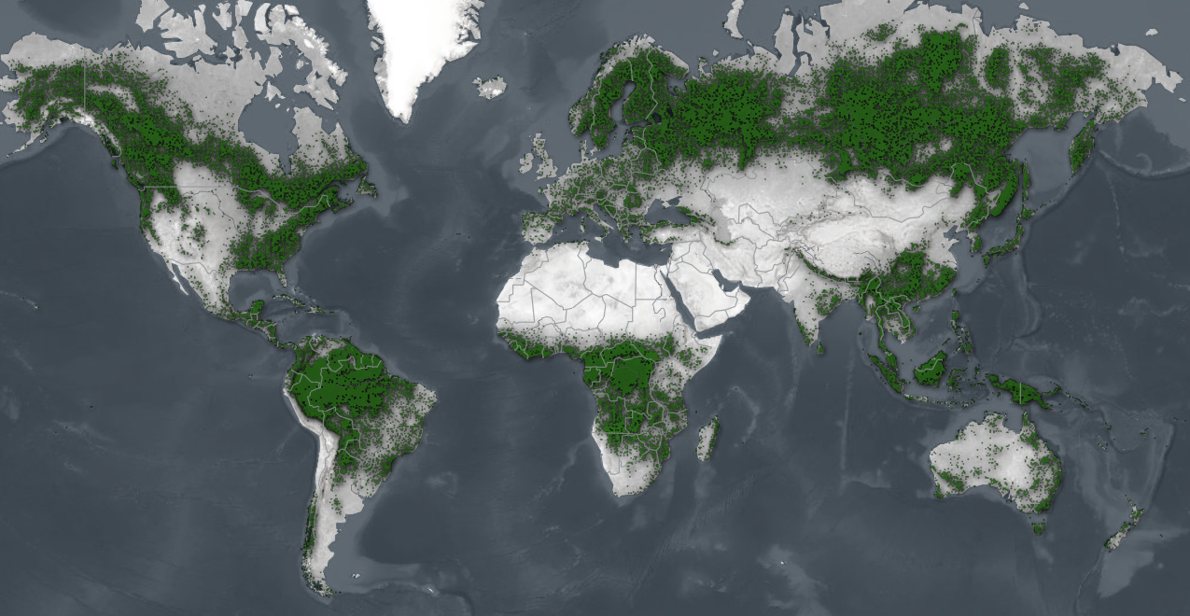
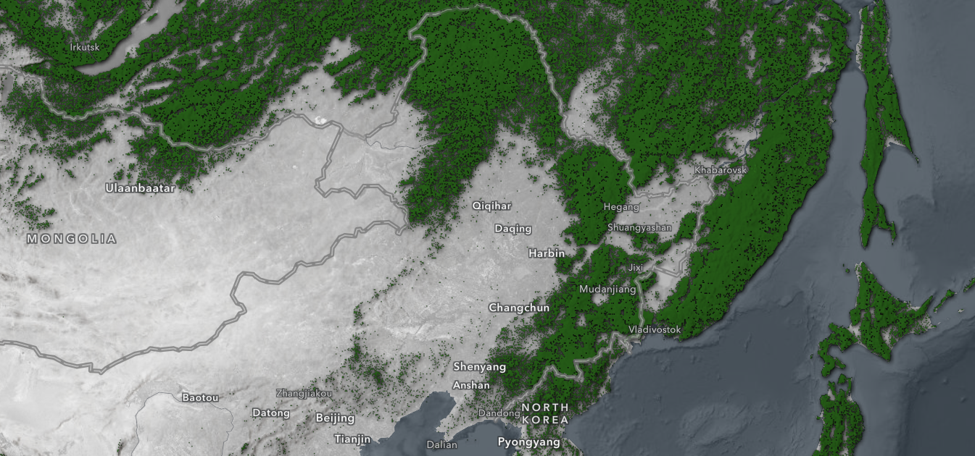
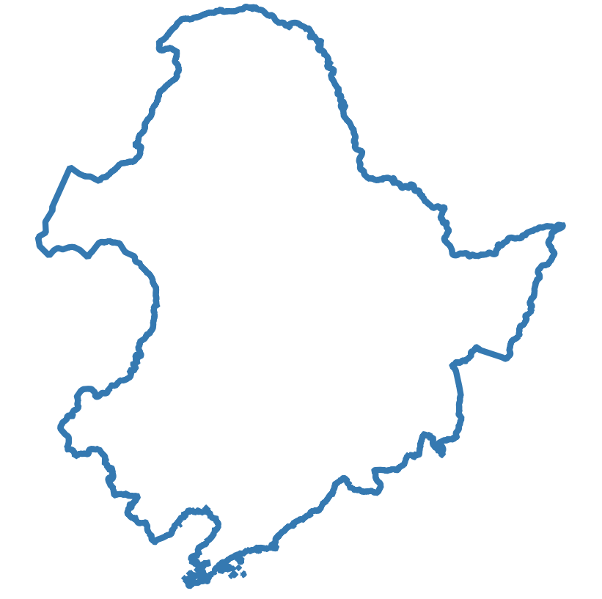


Forests: 31% of the global land area
Important carbon sinks
Forest cover in Northeast China
Global forest cover, 2022
How to calculate forest carbon storage?
Traditional field survey: harvest and weighing, allometric equations, etc. (plot scale)
Forest aboveground biomass (AGB):
[Living vegetation above the soil]
(stem, branches, foliage, etc.)
Remote sensing: Optical imagery, radar imagery, LiDAR (region scale)
Source: Esri / Sentinel-2 Land Cover Explorer; FAO and UNEP, 2020, The State of the World’s Forests 2020; M.S. Ashton et al., 2012, Managing Forest Carbon in a Changing Climate.

Slide 2

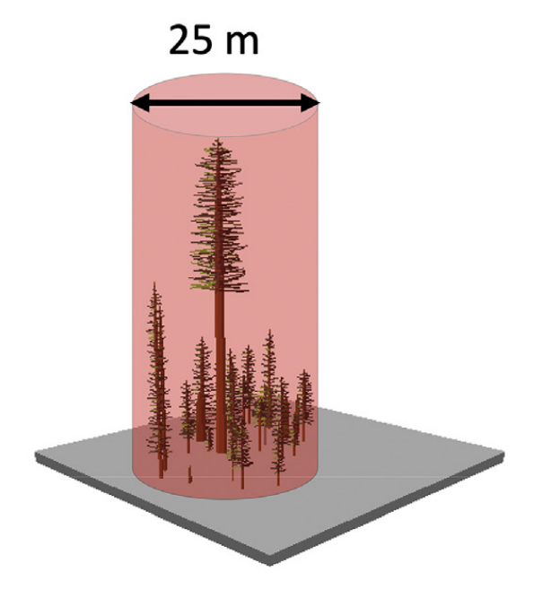
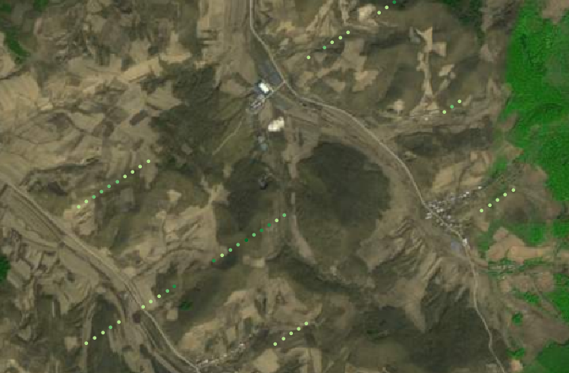
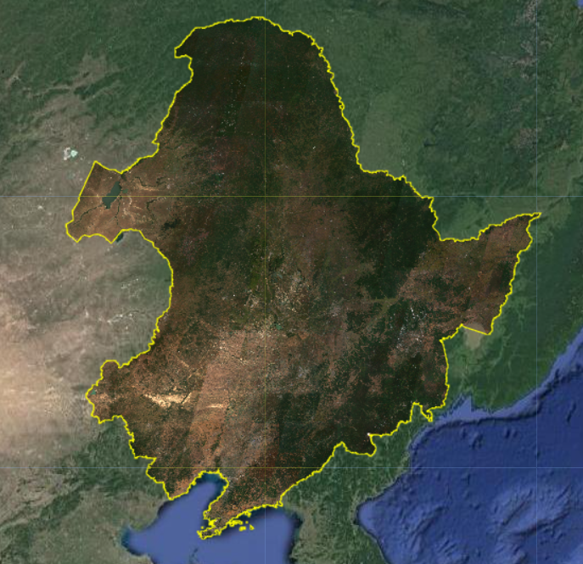
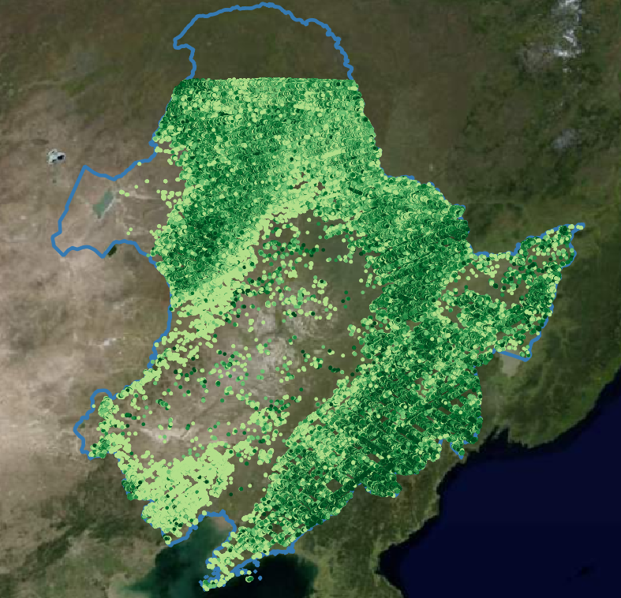
2022.04 – 2022.09
 | AGBD | Lat | Lon | Band1 | Band2 | … | Band12
0 | 63.10 | 45.37 | 123.09 | 0.025 | 0.029 | … | 0.083
1 | 75.70 | 46.33 | 125.61 | 0.028 | 0.026 | … | 0.060
2 | 71.38 | 46.33 | 125.61 | 0.028 | 0.026 | … | 0.069
… | … | … | … | … | … | … | …
5716319 | 93.83 | 44.85 | 130.71 | 0.039 | 0.033 | … | 0.108
Sentinel-2 L2A
GEDI L4A
Continuous image
Sparse points
10m resolution
25m diameter circle
12 bands values
AGBD values
Source: Dubayah, R. et al., 2020, The Global Ecosystem Dynamics Investigation: High-resolution laser ranging of the Earth’s forests and topography.

Slide 3




12 bands values
Regression
AGBD values
Lat + Lon
Train/validation/test split
Train/test split
Train/test split
StandardScaler
1-D CNN
StandardScaler
ANN
RandomForestRegressor
XGBRegressor
LGBMRegressor
Conv1D (64, 3, ReLU) ×2
Maxpooling (2)
PCA
Dense (128, ReLU)
Conv1D (128, 3, ReLU) ×2
Dense (64, ReLU)
Maxpooling (2)
LinearRegression
Dense (32, ReLU)
Conv1D (256, 3, ReLU) ×2
Maxpooling (2)
Dense (16, ReLU)
Flatten
MSE & R²
MSE & R²
Dense (1, Linear)
Dense (128, ReLU)
Dense (1, Linear)
MSE & R²

Slide 4

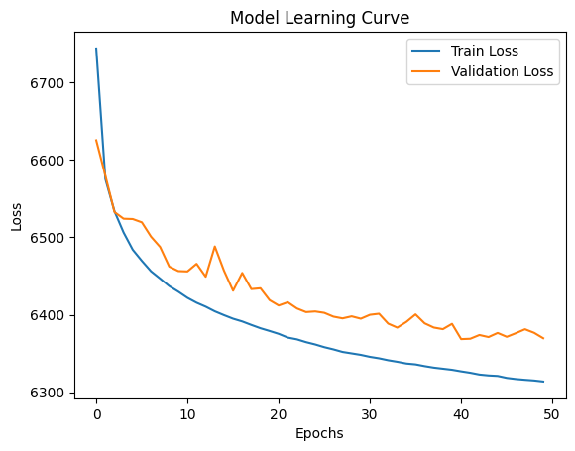






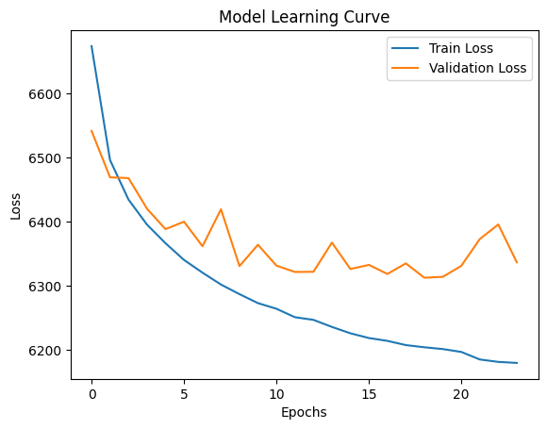



Test:
MSE=6301,
R²=0.148
Train: MSE=7158, R²=0.036
Test: MSE=7220, R²=0.036
Optimizer: Adam
Loss: MSE
Epochs: 50
Batch size: 256
Callbacks: 5
Underfitting?
n_estimators=50:
Train: MSE=782, R²=0.89
Test: MSE=5424, R²=0.28
Overfitting?
Test:
MSE=6266,
R²=0.153
n_estimators=50, max_depth=120, min_samples_leaf=5, max_features=20:
Train: MSE=2740, R²=0.63
Test: MSE=5393, R²=0.28

Slide 5

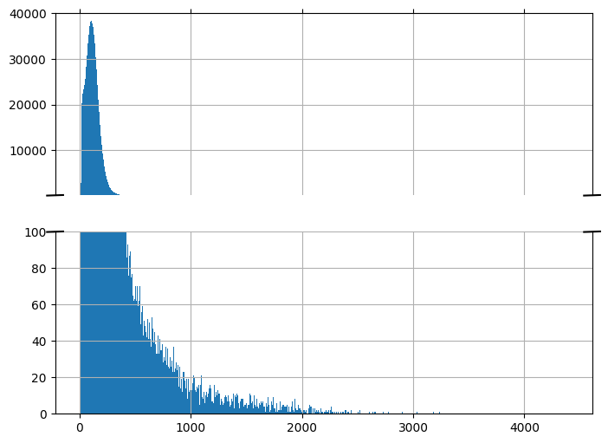
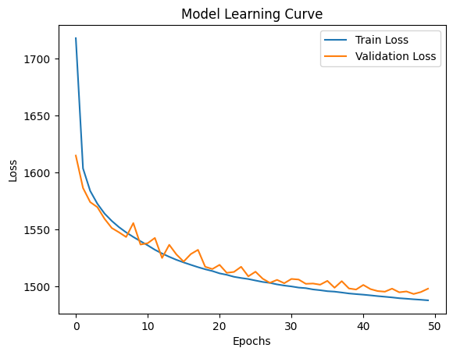

If only samples
with AGBD values between
20 and 200 Mg / ha are used:
Test:
MSE=1494,
R²=0.276
Unevenly distributed AGBD values

